Slide 1
Accessibility Testing with Screen Readers & More
Erissa Duvall

Slide 2









Cincy Deliver 2024 Sponsors
Dimond
Gold
Silver

Slide 3

Disclaimer
The views expressed in this presentation are those of this speaker and do not necessarily represent those of their employer.
Accept to Continue
Erissa

Slide 4
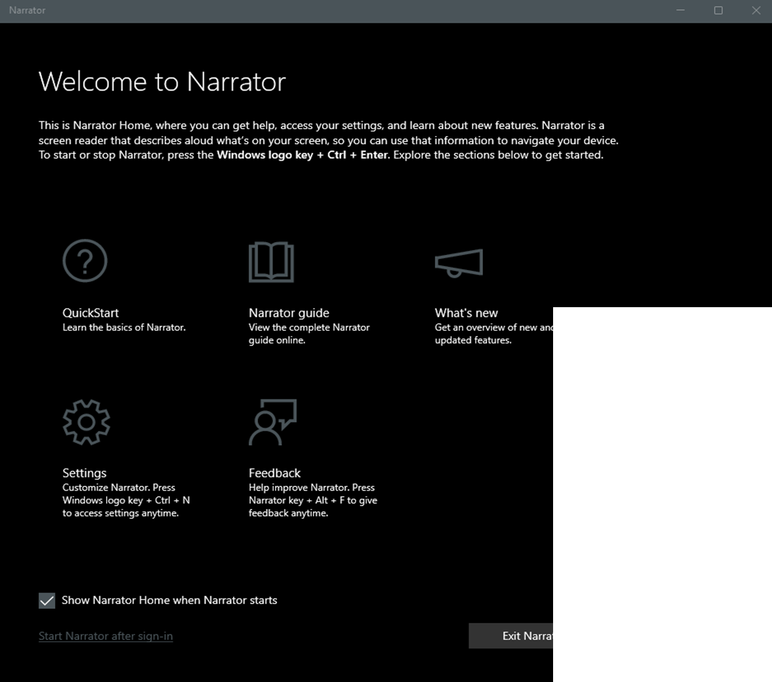
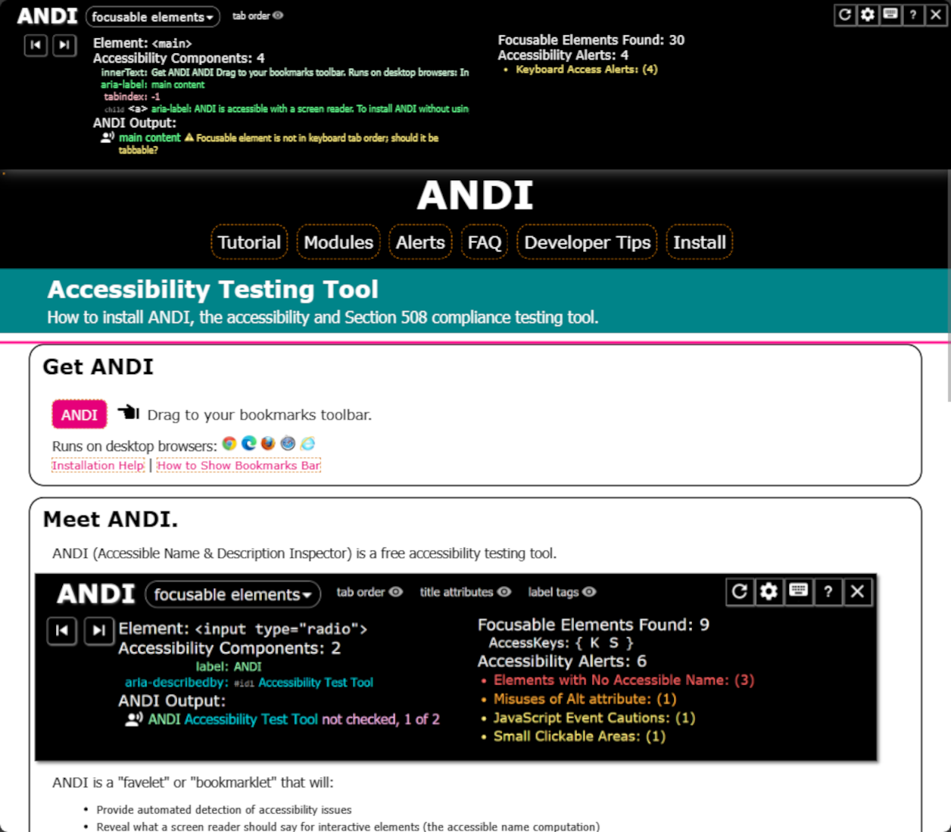
Agenda
Accessibility & Disability
What are we looking for?
Why not just automate?
Tool Examples
Known Issues
Testing Combinations
Demo Time
Resources

Slide 5
Accessibility & Disability
Quick Summary
Erissa
Notes:
These descriptions are very simplified for time. I go more in-depth on discussing them in my Introduction to Accessibility talk.
Accessibility is just how well can facilities, content, features, processes, policies, etc. be used/followed by users of all abilities. With regards to digital content, is it flexible enough for people to use it with/without assistive technologies.
Disability is most easily thought of as is the environment creating a barrier to certain groups of people that isn’t caused for other groups. In this case, we are not just looking at barriers caused to people with medical conditions, but also people who may be commonly visiting the content while in a state of distress, in an environment where they cannot easily hear audio cues, maybe viewing a screen in a very brightly/dimly lit environment, viewing while on a poor connection, etc.

Slide 6
What are we looking for?
Can users perceive, operate, and understand the content/functionality with or without the aid of assistive technologies?
Erissa
Notes:
To that end we are looking at how accurately, clearly, and consistently the content is communicated.
Some of what we are looking at, include:
Structure
Headings
landmark regions (header, main, footer, nav, form, etc.)
Relationships
heading to its content
heading to other headings (not having to headings as H2s even though one is meant to be under the other)
label to its input
Lists (ordered vs unordered)
Function
links vs buttons
radio vs checkbox
special formatting requirements for a field to validate
how to access/expand a widget
conflict with existing common user key shortcuts
Information
Not just using color
Accessible labeling
Proper color contrast
CSS images not the only way of conveying information

Slide 7
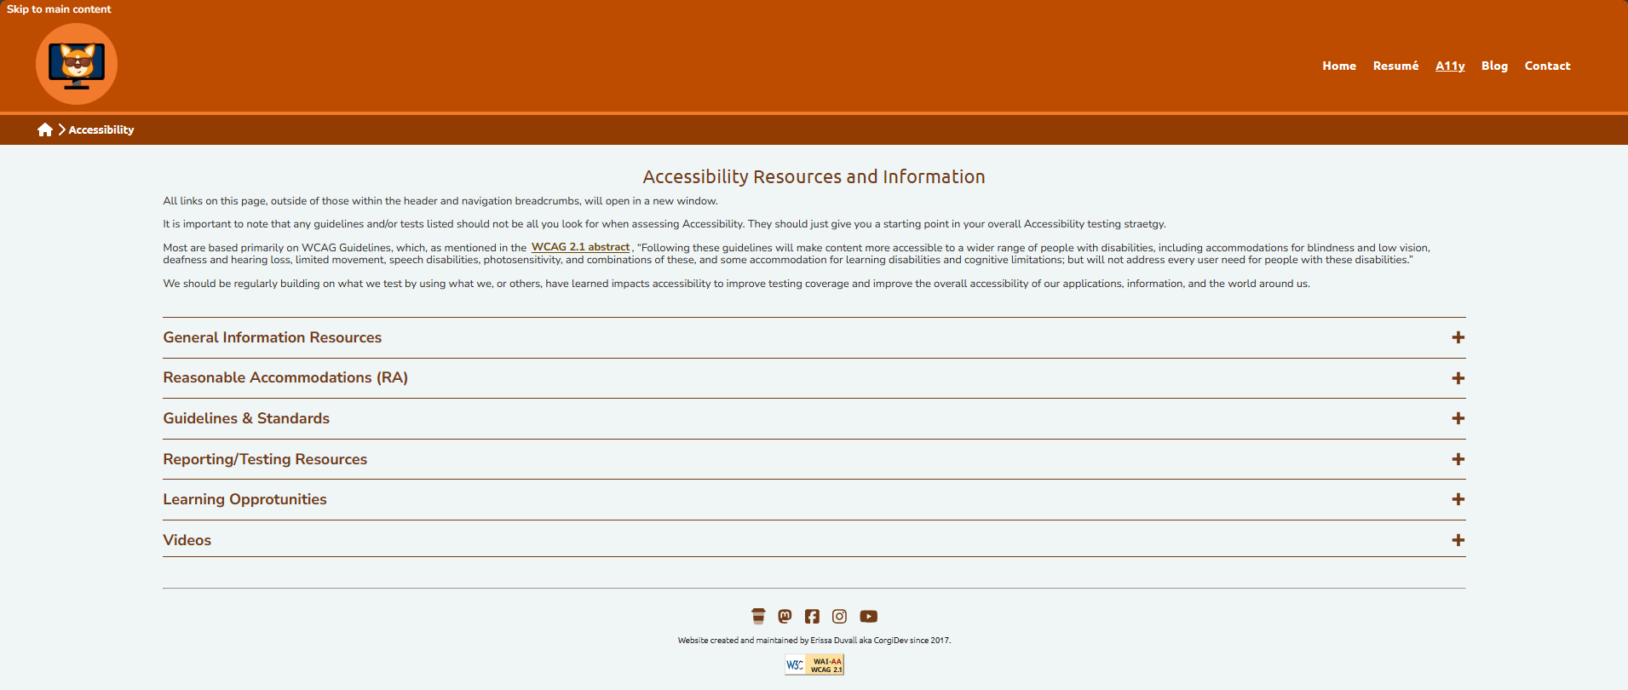
What are we looking for? – Example 1
Erissa
Notes:
Https://corgidev.com/a11y.html

Slide 8
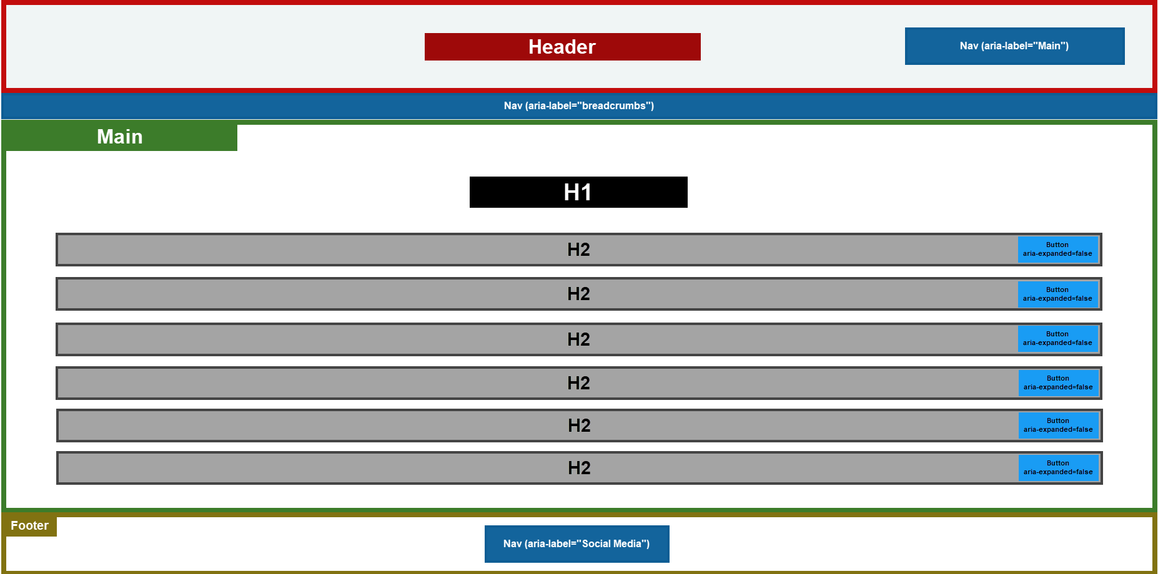
What are we looking for? – Example 2
Erissa
Notes:
Header
Nav: aria-label=“Main”
Nav: aria-label=“Breadcrumbs”
Main
H1
H2
Button with an aria-expanded attribute
H2
Button with an aria-expanded attribute
H2
Button with an aria-expanded attribute
H2
Button with an aria-expanded attribute
H2
Button with an aria-expanded attribute
H2
Button with an aria-expanded attribute
Footer
Nav: aria-label=“Social Media”

Slide 9
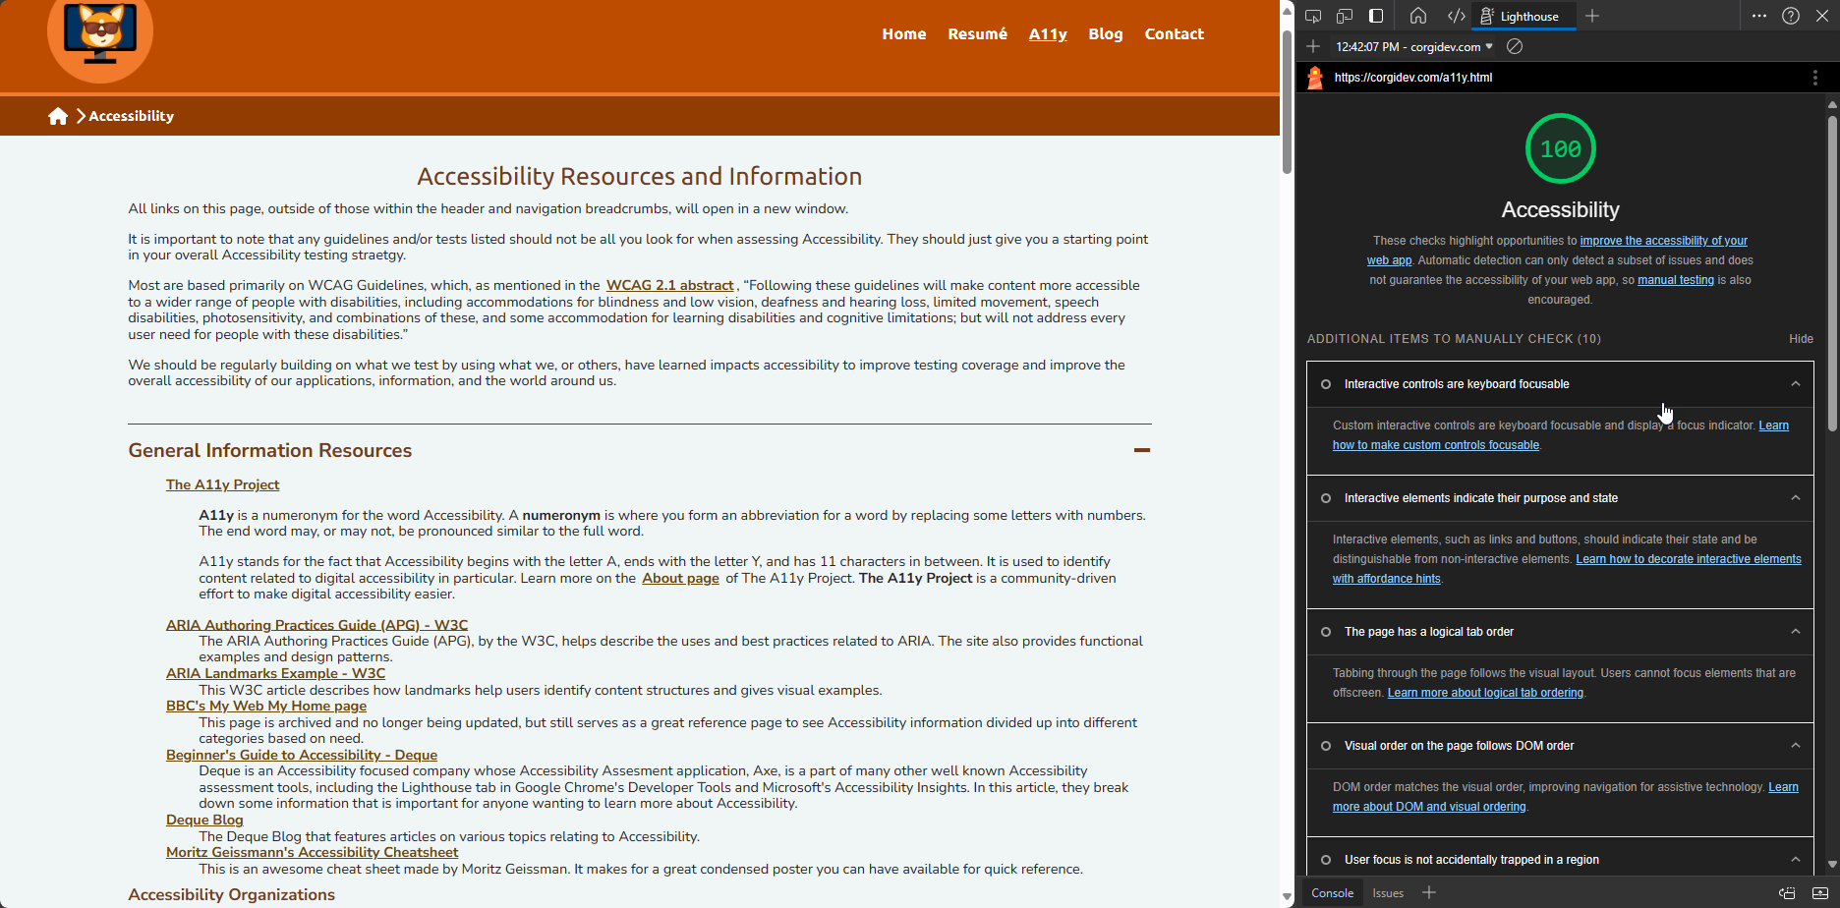
Why not just automate?
Erissa

Slide 10
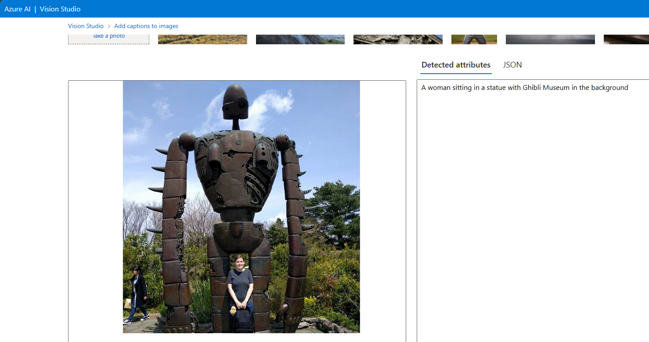
Why not just automate? - Continued
Erissa
Notes:
Azure Vision Studio - https://portal.vision.cognitive.azure.com/demo/image-captioning

Slide 11
Tool Examples
Bookmarklets
Browser Extensions
Desktop Applications
Screen Readers
Other
Landmarks
Headings
Lists
Lang
Text Spacing
ANDI
Target Size
Accessibility Insights
Axe DevTools
WAVE
Web Developer
Color Contrast Analyser (CCA)
PDF Accessibility Checker (PAC)
Photosensitive Epilepsy Analysis Tool (PEAT)
ZoomText
Fusion
Dragon
JAWS
NVDA
VoiceOver
Narrator
TalkBack
Axe Linter
Erissa

Slide 12
Known Issues
Issue Trackers
https://issuetracker.google.com/
https://issues.chromium.org/
https://bugs.webkit.org/
https://github.com/nvaccess/nvda/issues
https://applevis.com
Example Known Issues
Android: TalkBack doesn’t always read required attributes even when you use aria-required.
MacOS & iOS: When using VoiceOver & Safari, unordered lists that have had their styling removed won’t be read as lists consistently.
Erissa

Slide 13
Testing Combinations
Operating System | Platforms | Browsers | Screen Readers
Windows | Desktop | Edge Chrome Firefox | Narrator NVDA JAWS
MacOS | Desktop | Safari Chrome Firefox | VoiceOver
Android | Mobile | Chrome Firefox | TalkBack
iOS | Mobile | Safari Chrome Firefox | VoiceOver
Erissa

Slide 14
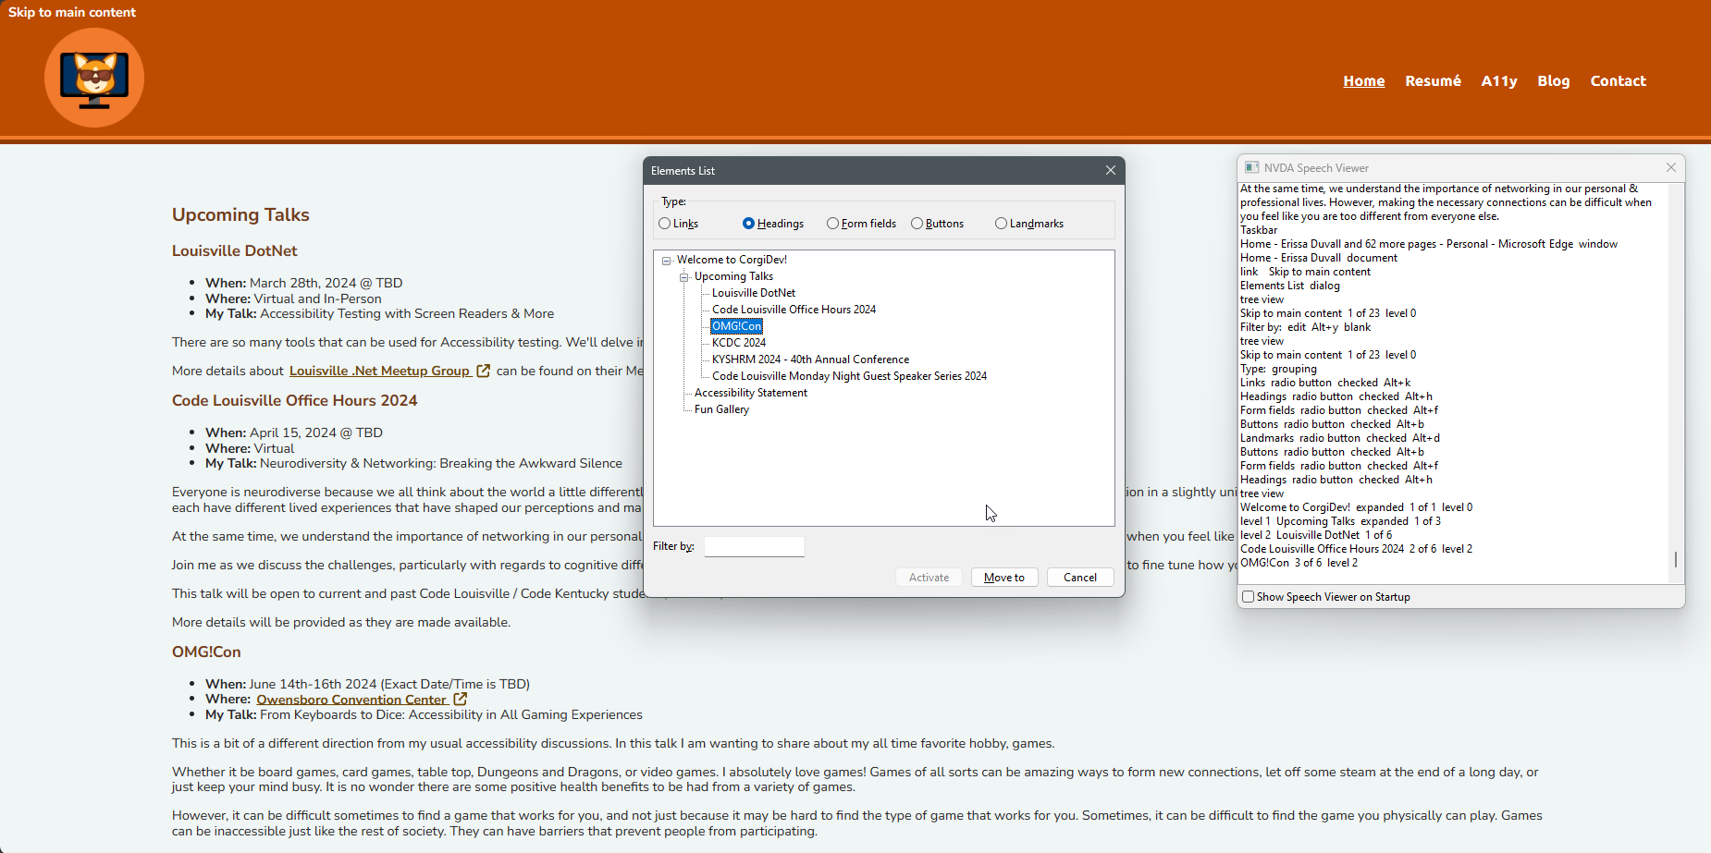
Demo Time
Screen reader audio may not be audible for people watching virtually but will be visible.
Interesting Note: If you are using operating system color filter settings, note that those are often not visible to people who may be watching you streaming.
Erissa

Slide 15
Thank you & QA
Erissa Duvall
www.corgidev.com
Feedback @ accessibility@corgidev.com
Erissa

